Slide 1


Smartathon Theme 1
Visual Pollution detection using Object Detection
By Bunty Shah and Pankti Shah

Slide 2




Project Overview
Visual Pollution Detection Using Object Detection
Below are the core areas of focus while implementing the solution:
Data Centric Generalizable Modelling
MLOps Practise
Deployment/Inference
Scalability
Accurate low data produce better results then building large models.
We have tried and improve data or augmentation to improve score then using bigger and bigger model.
We have tried to make model as generalized as possible and should not overfit the training set.
We have integrated ML Ops practices like experiment tracking, error analysis etc
MLOps approach gives us way to do continuous training and continuous improvement of the model.
We have taken deployment scenarios and inference timing/speed into consideration while trying to create the model.
Such models are usually deployed over edge devices, so we tried to keep model as small as possible.
We have taken consideration of scalability of training and inference as we get more and more data.
Scalability can be done in ETL process, data distribution or model distribution based on research from tools like tensorflow profiler.

Slide 3
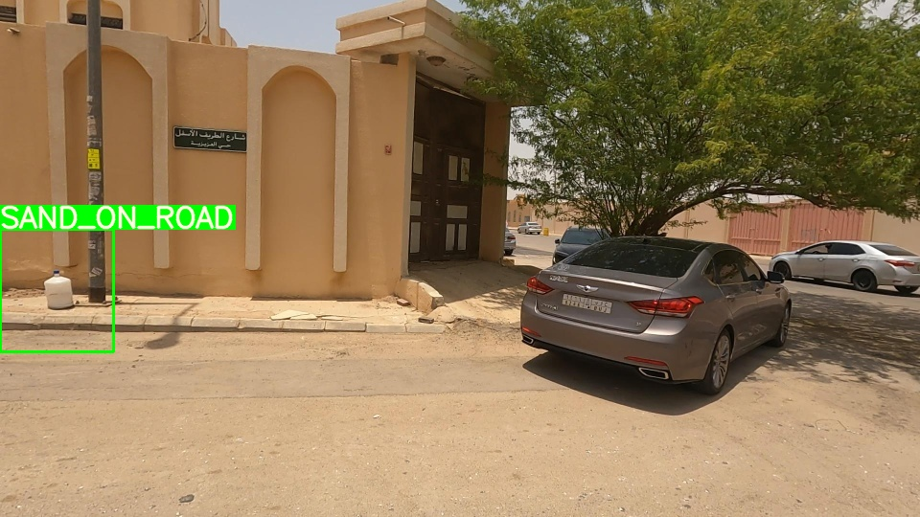
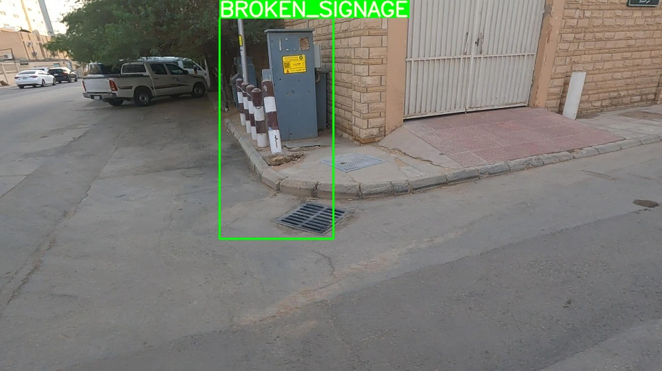
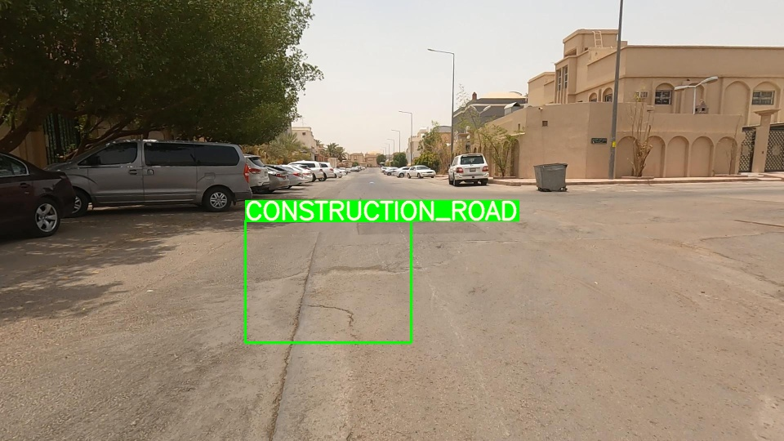
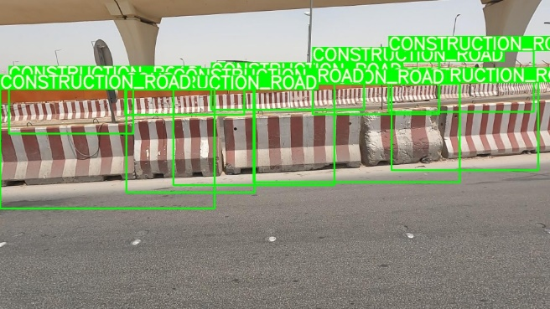
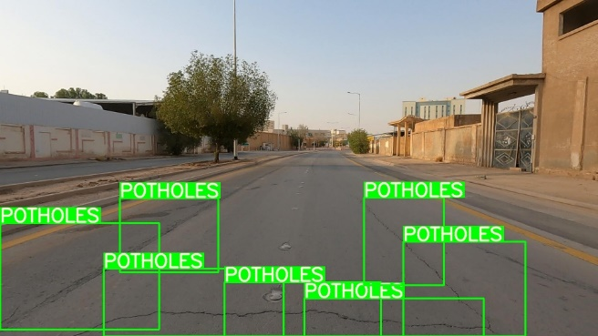
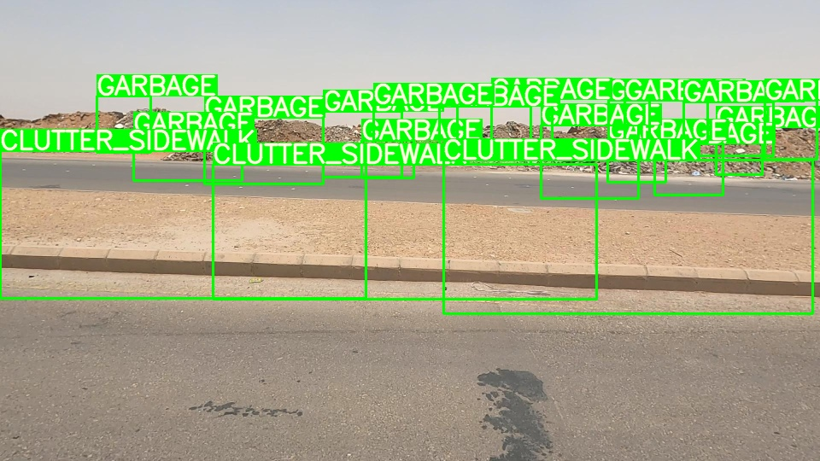
Data Centric Generalizable Modelling
We have performed below steps to increase accuracy by changing the data and make model more generalize
We have removed below data by looking at those data manually
Wrongly labelled like below:
Too many bounding boxes
3. Custom stratified train and test split to maintain data distribution to make it better generalized.
4. YOLO does basic augmentation like Mosaic (Creating new image from multiple images), Degree, Scaling,
flipud and fliplr. There are other augmentation but it was not contributing to score.

Slide 4
ML Ops Practises
We have used Weights and biases to track experiments and do error analysis on the data to continuously improve and train the model in an iterative fashion. You can find experiments report https://wandb.ai/buntyshah/YOLOv5/reports/Smartathon-Theme-1--VmlldzozMzg1NDQ4?accessToken=wgde7dk6z7eweepuwct7qm2av7jcq1n1893lowdjvvoixhjw7g3408nz0q7ed0zm
Deployment/ Inference
We have used YOLO which can be converted into multiple formats like TFLite which can be then deployed on edge devices
Scalability
We have trained this model on multi GPU instance
We can run TF profiler to check bottlenecks in training and inference, based on that we can either distribute data or model based strategy.
This model can be converted into formats like TFLite which can be deployed to edge devices.
YOLOV5
Yolo V5 architecture and COCO metrics are available here https://github.com/ultralytics/yolov5
Training code and model weights
Training code and model weights are available here https://github.com/buntys2010/Smartathon-Theme-1

Slide 5
Current Solution
Below is our solution architecture to solve the problem
Training Images
YOLOV5 file format
Images
Resize the images (50% Reduction)
Groupby bounding boxes
Train-Test Split (Stratified and Random)
YOLOV5 Model training
Validation Images
YOLOV5 file format
Manual Data Clearing
Weight Files
Predictions
Test Images
Resize the images (50% Reduction)
Final Submission

Slide 6
Challenges faced in data preparation
Data preparation and its challenges and how did we solved those
Wrongly labelled data - As described in slide 3, we have manually removed wrongly annotated class data.
Multiple labels – To further clean the data and avoid model confusion to predict multiple bounding boxes, we removed multiple bounding boxes data in training set as show in slide
Class imbalance: We did custom stratified split for training and validation to make sure we have proper distribution while training. We did tried to apply class weights but there was no significant gain.
Bounding Box improvement: We have created a custom bounding box functions to solve bounding box going outside the image.
Final image size adjustment: on larger image, if we multiply bounding box by 2 then we are increasing bounding box size by factor of 2 which may create bad training data. To solve this challenge, we reduced the size of the image by 50%

Slide 7
How to make the process more scalable
Describe how you would make your solution more scalable
Training Data Annotation scalability
Training Infrastructure scalability
Active learning can help annotate required images which can produce better models. (Reference)
A good high precision baseline model can help annotate images at large scale with good confidence, we can only look for images with low confidence to be annotated.
Crowdsoursing platform can make annotation much more scalable.
Training infra scalability depends on the bottleneck of the process. We can run TF profiler to understand bottlenecks and act on the same.
Based on the analysis, we can perform data or model distribution strategy to scale the training, auto-scaling, data pipeline etc.
MLOps Scalability – CI and CD
Inference Scalability
Tools like W&B for experiment tracking, Incoming ETL pipeline data anomaly, Error analysis, GPU/CPU utilization etc can be tracked.
Custom pipeline can be made for ETL, code deployment, auto training and deployment.
Human in the loop process with MLOps can scale the training and accuracy.
We can reduce the size of the model by quantization process to improve inference speed.
We can convert the models into formats like TFLite to deploy on edge devices.
7

Slide 8
Open Source Software List
List of open source software used
Open CV
Open CV was used to read and transform images
YOLO
YOLO Algorithm and pre-trained COCO weights are used to fine tune the model
Pandas and NUmpy
Pandas and Numpy is used to read files and manipulate the data.
Pytorch
We have used pytorch framework to build, load model.

Slide 9
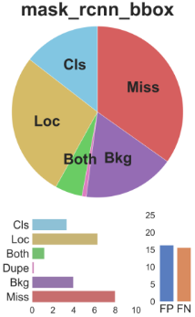
Future Development
Describe what you would want to try if you had more time / resources / data to resolve the problem
Labelling Process: We can create an annotation guideline to create annotations for labellers to create annotation consistency.
Labelling automation: If we have millions of images, instead of labelling all of them we can apply active learning to annotate important images.
We wanted to do active learning by training a baseline model and then predict on the training set, the images with lower confidence can be labelled or improved for further precision improvement, this will improve efficiency of the process and achieve more then 50% cost reduction.
Prediction/Error Analysis: To improve precision, the model can be producing wrong classification, localization or both. We wanted to create custom script to understand issues with prediction to improve precision value (Similar to below analysis)
Long training: Since we have used optimized hyper parameters, given good infrastructure we can run for larger epochs (more then 300) to improve on precision without overfitting.
Augmentation: More augmentation to reduce class imbalance.
Pseudo Label-Guided Sampling - we train a network twice and use the pseudo labels generated from the first model to guide the training of the second model. We filter prediction results of a trained model to generate pseudo labels to complement sparse annotation for unannotated regions.
Different sampling technique listed here
Uploading 10% of background image (blank image without any bounding box) to reduce FP.

Slide 10
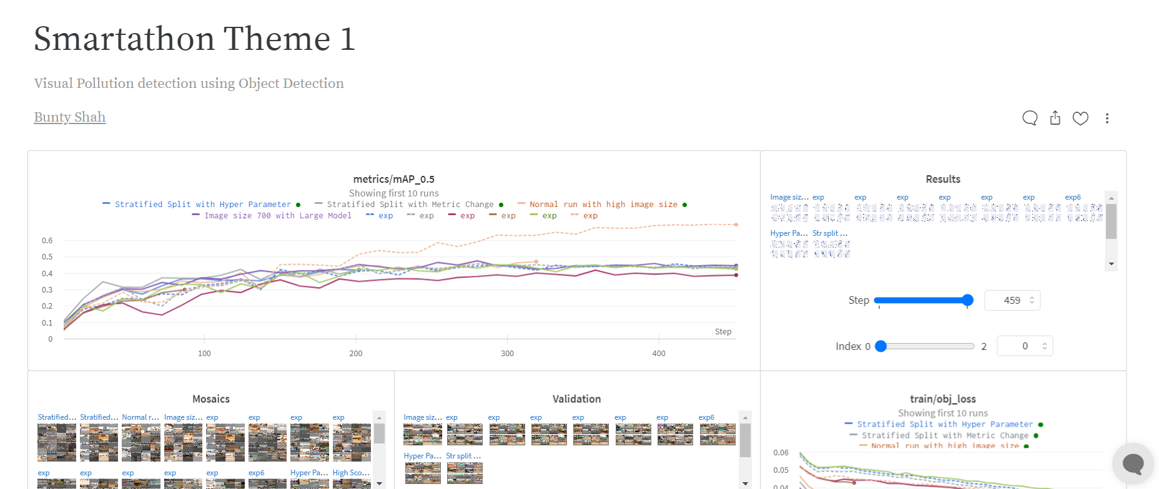
Things tried during experiment process
Reduce size of bounding boxes by 5% - We tried an experiment where we reduced size of the bounding boxes by 5% to improve localization problem. We haven’t received significant accuracy gain.
Augmentation and Hyper-parameter tuning- We have tried to change augmentation and Hyper-parameter tuning with BCS loss function to balance imbalance problem.
Stratified split : We created a custom stratified split to maintain class balance in training and validation but it didn’t show significant accuracy improvement.
List of all experiments is listed here in the report:
https://wandb.ai/buntyshah/YOLOv5/reports/Smartathon-Theme-1--VmlldzozMzg1NDQ4?accessToken=wgde7dk6z7eweepuwct7qm2av7jcq1n1893lowdjvvoixhjw7g3408nz0q7ed0zm

Slide 11
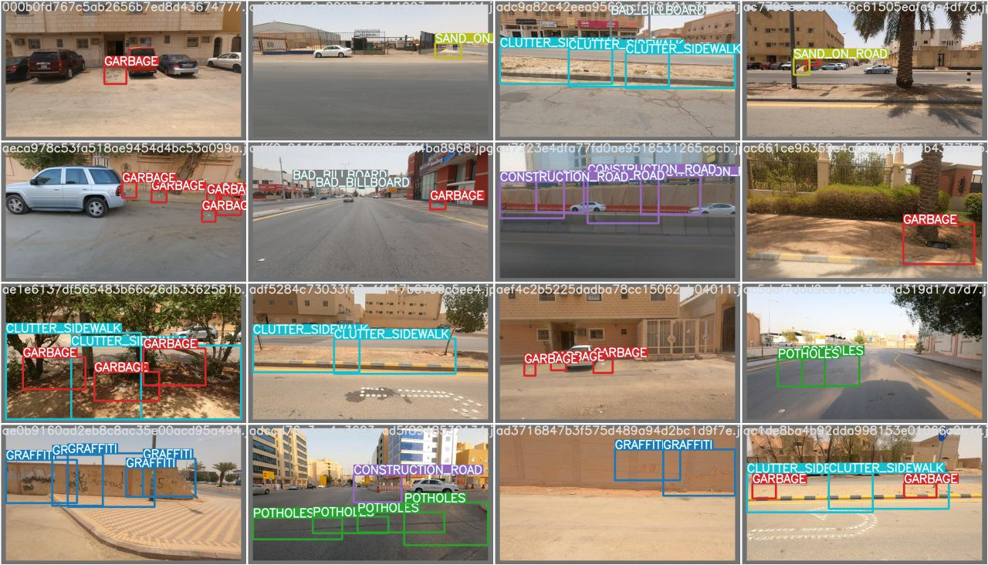
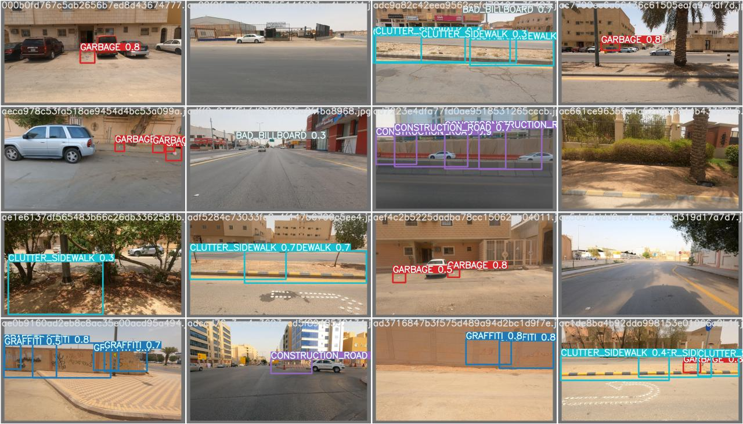
Model Results
Actual Labels
Predicted Labels

Slide 12
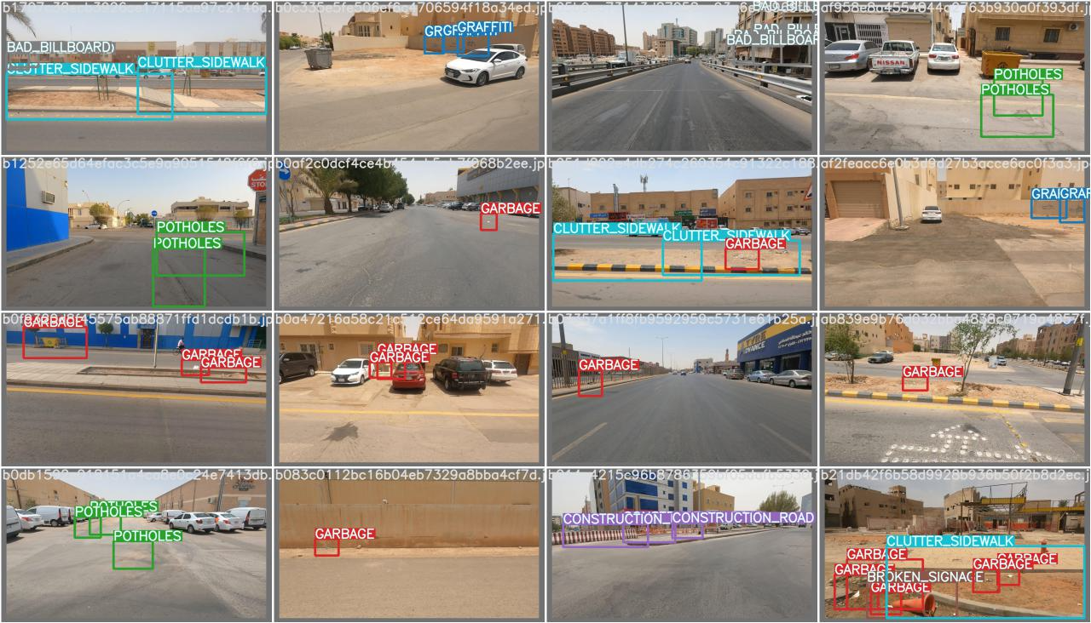
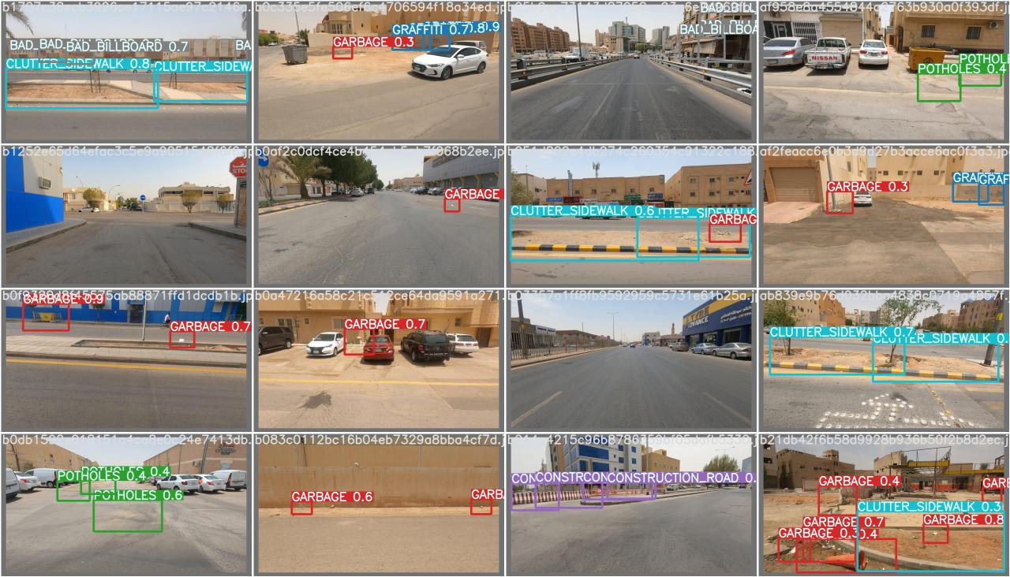
Model Results
Actual Labels
Predicted Labels

Slide 13
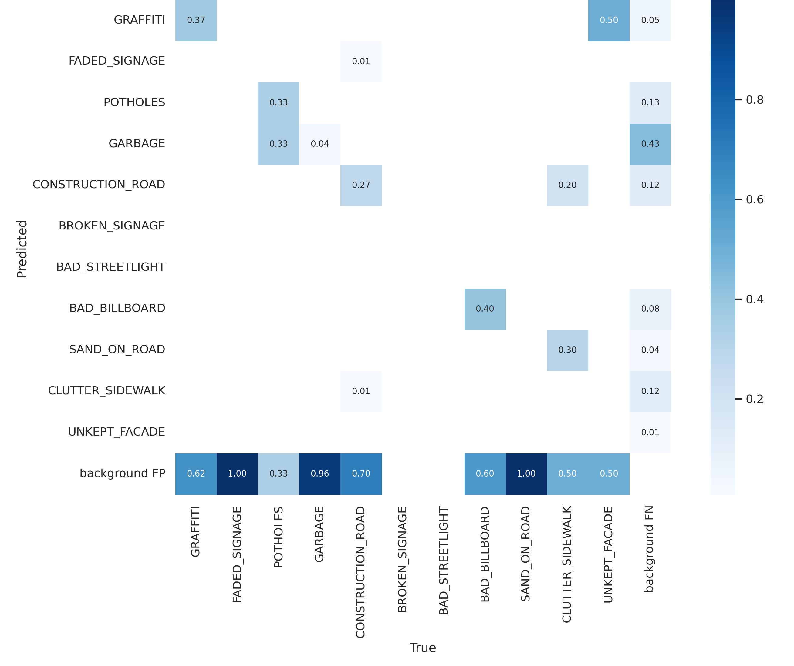
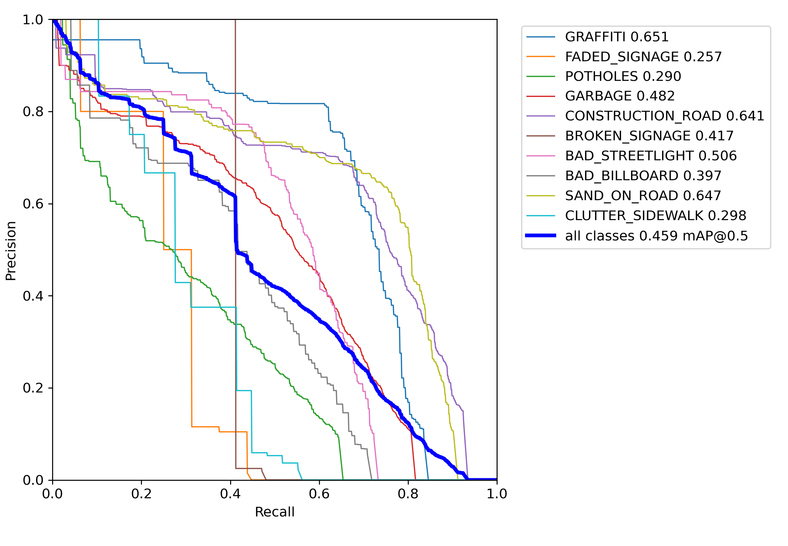
Model Results

